Slide 1

Do you want to be a Columbus?
- The Second Columbus
Copyrightⓒ AQUA. All Rights Reserved

Slide 2

Company & Job

Slide 3

Company introduction
History of Columbus Company
ㆍNov. 2000 Founded the Columbus Company
ㆍSep. 2005 Ranked on the top of the
‘Foreigners transmission performance’ field
ㆍMarch. 2006 Wont the first Prize
‘The most admired Company in South Korea’
for three years in a row
ㆍMay. 2012 Conclude the contract with the
‘Silken Puerta America Hotel’ (Sweden)
ㆍ June. 2014 Move of the Head Office to Daegu

Slide 4


The right people for the Company
Copyrightⓒ AQUA. All Rights Reserved
Customer Value Creation
Service professional
Global
The leader of the world
Constant Learning

Slide 5

Looking for the...
Second Columbus!

Slide 6
The Purpose of the ‘Second Columbus’
Check the business value
of our travel package

Slide 7


Copyrightⓒ AQUA. All Rights Reserved
Duties

Slide 8

What should you do?
Take our new tour package
Follow all of our schedule actively

Slide 9
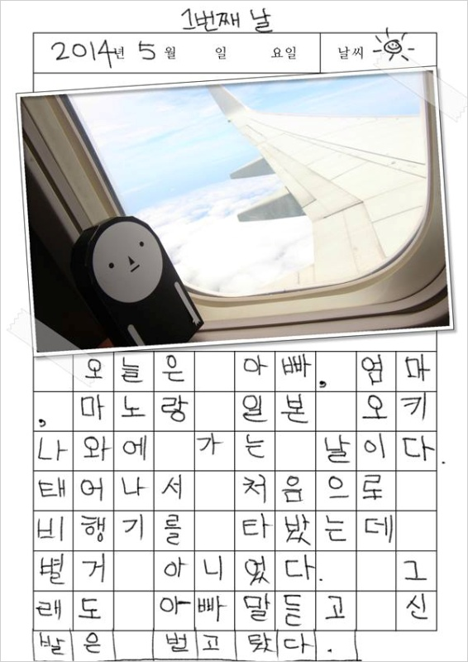
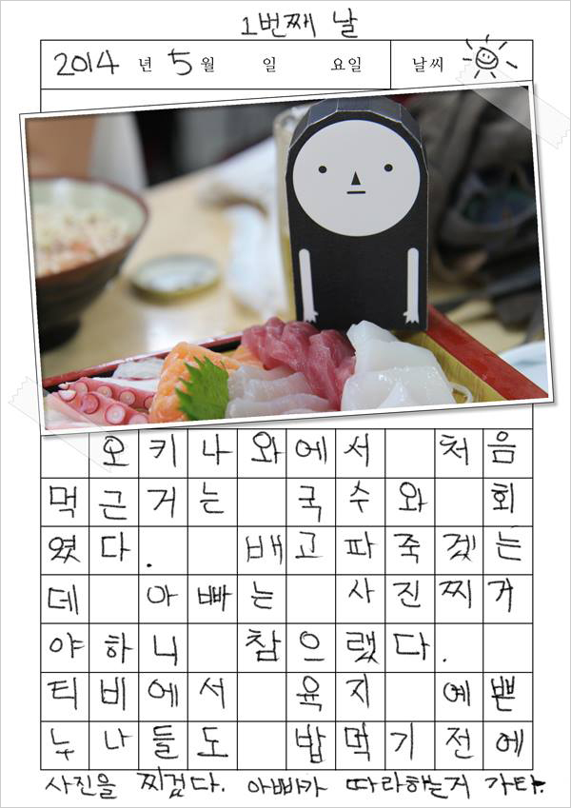
What should you do?
Write the journal everyday
About what?
: Advantages / disadvantages
Meal
Traffic
Accommodation
Safety

Slide 10
Benefits

Slide 11


Benefits

Slide 12

You need No Charge!
First

Slide 13
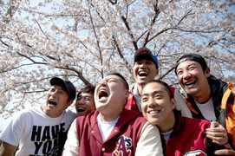
One more Travel

Slide 14


TRAVEL
EXPENSE

Slide 15
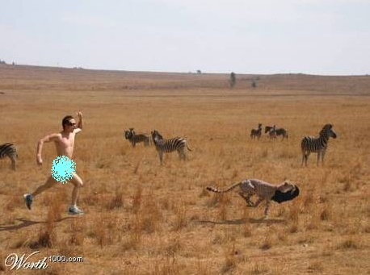

Don’t Worry!!
Insurance!

Slide 16


Copyrightⓒ AQUA. All Rights Reserved
Qualifications

Slide 17
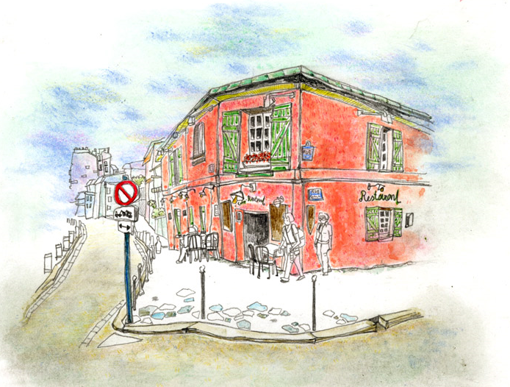
Qualifications
Foreign language skills
Travel experiences
Adaptability to circumstances

Slide 18

Copyrightⓒ AQUA. All Rights Reserved
How to apply

Slide 19

How to apply
Send documents
Personal data
Medical checkup table
Travel journal
columbus@gmail.com
More information
www.the2ndcolumbus.com

Slide 20
Do It Right Now!

