Slide 1
Mars Frontier

Slide 2
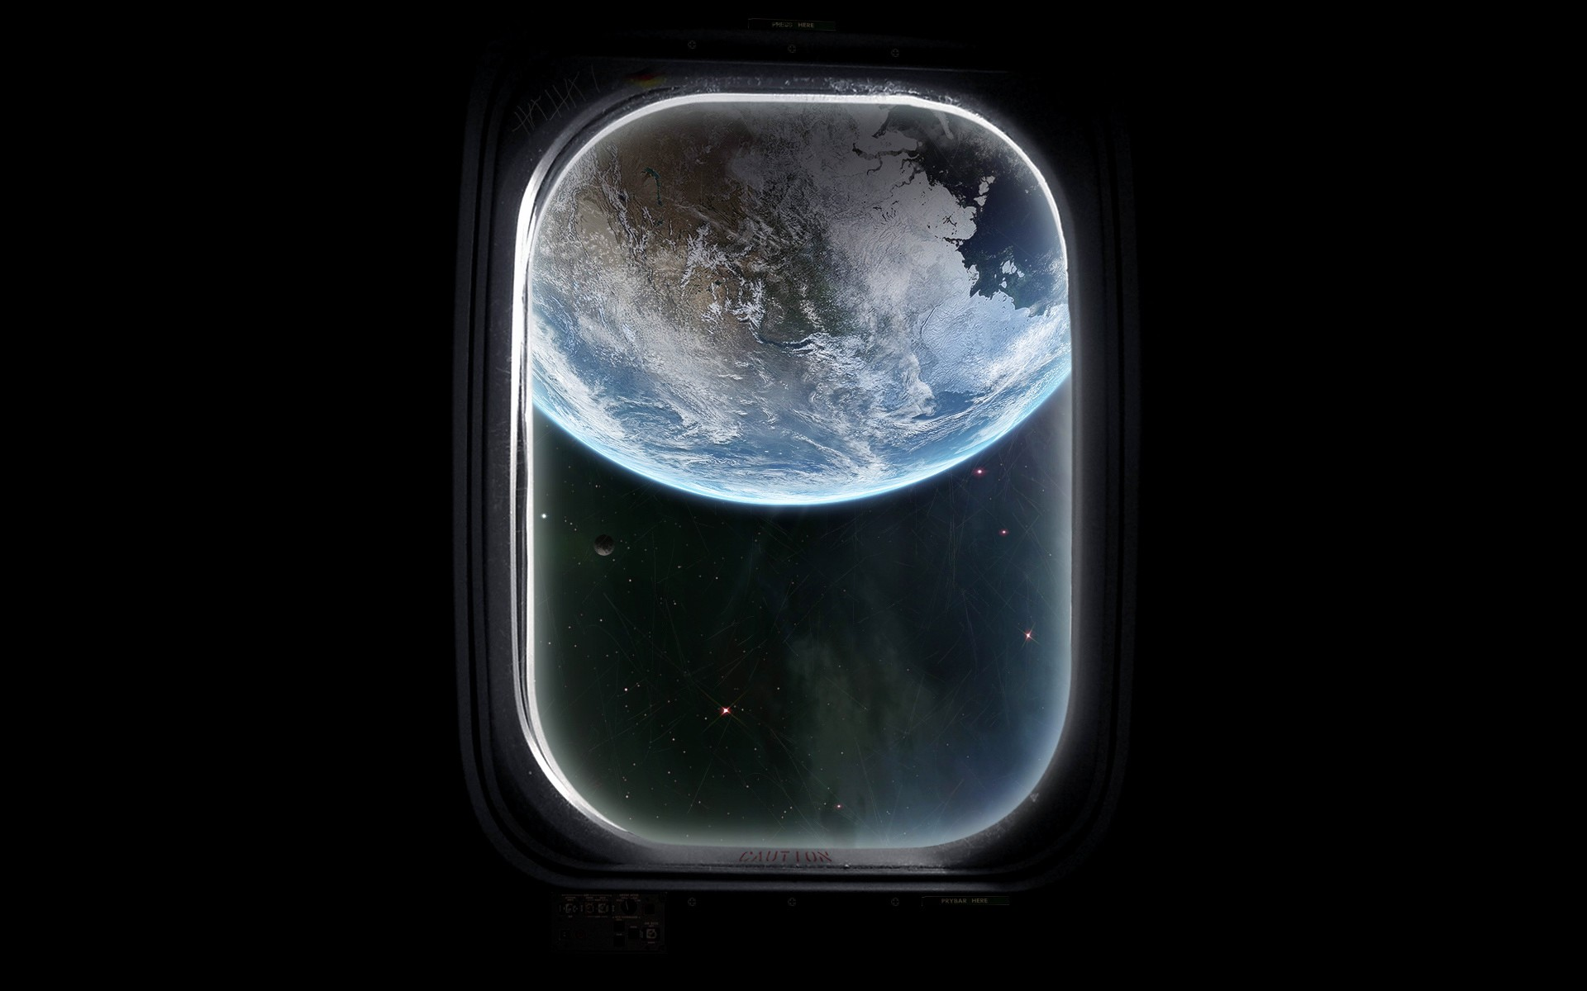

Slide 3

Great Nathan

Slide 4

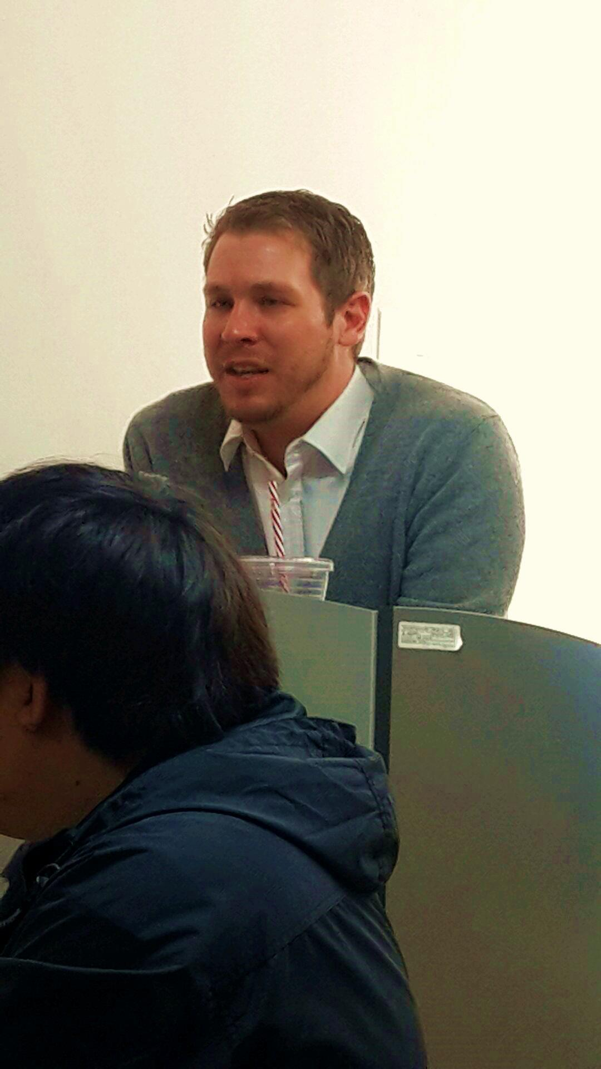
Founder of the Company
1810
Sir. Henry Nathan the Great
(1780~1860)
Majored in Architecture
Known as one of the early Pioneers

Slide 5
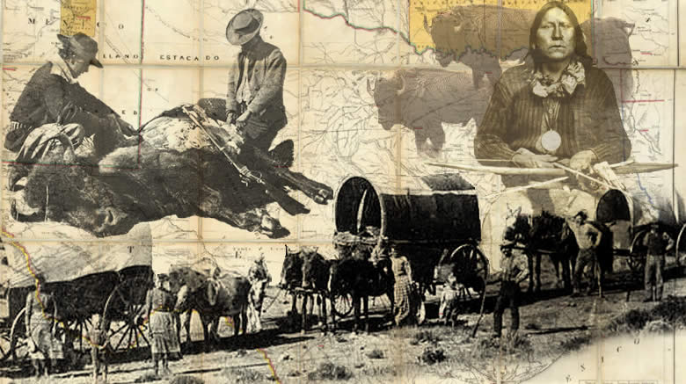
History of the Company
Go West!!

Slide 6

What the Company does

Slide 7

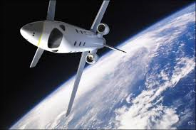

Slide 8




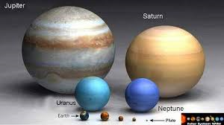

Slide 9


Slide 10
Purpose of MARS FRONTIER
Confirm whether our apartment is fine for people to live on the Mars
To find and compensate problems

Slide 11
Things to Do
Live in G.N apartment for six months
Use facilities(fitness center, play ground) in apartment
Record good or bad points of our apartment
Have a good relationship with neighbors

Slide 12
Qualification
4-membered family
Healthy
Experience of living at apartment at least 10 years
Communication skills
No education limits

Slide 13
Benefits
$1,000,000 per one family
Social insurance
Vacation for 5days
Get a chance to travel the Mars

Slide 14
H.P : 070-4050-0504
E-mail : gnathan@gmail.com

